Slide 1
Machine Learning
Instructor: Zainab Yousuf

Slide 2
“Learning is any process by which a system improves performance from experience.” - Herbert Simon

Slide 3
What is Machine Learning? A definition
Machine learning (ML) is an application of artificial intelligence (AI)
ML provides systems the ability to automatically learn and improve from experience without being explicitly programmed.
Machine learning focuses on the development of computer programs that can access data and use it learn for themselves.
The process of learning begins with observations or data, such as: direct experience, or instruction, in order to look for patterns in data and make better decisions in the future based on the examples that we provide.
The primary aim is to allow the computers learn automatically without human intervention or assistance and adjust actions accordingly.

Slide 4
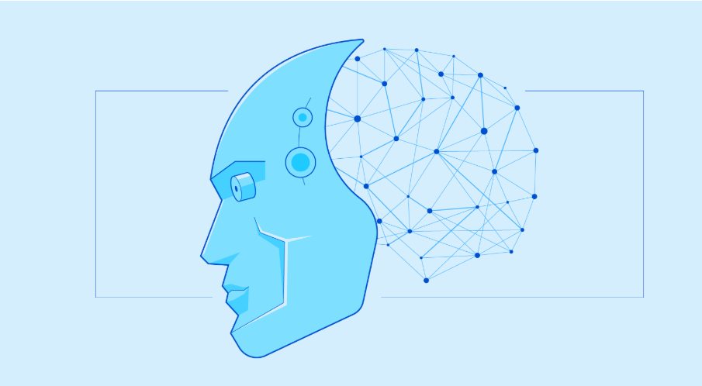
What is Machine Learning? A definition
Definition by Tom Mitchell (1998):
Machine Learning is the study of algorithms that
improve their performance P
at some task T
with experience E
A well-defined learning task is given by .

Slide 5
Defining the Learning Task- Examples
Improve on task T, with respect to performance metric P, based on experience E
T: Playing checkers P: Percentage of games won against an arbitrary opponent E: Playing practice games against itself T: Recognizing hand-written words P: Percentage of words correctly classified E: Database of human-labeled images of handwritten words | T: Driving on four-lane highways using vision sensors P: Average distance travelled before a human-judged error E: A sequence of images and steering commands recorded while observing a human driver. T: Categorize email messages as spam or legitimate. P: Percentage of email messages correctly classified. E: Database of emails, some with human-given labels

Slide 6
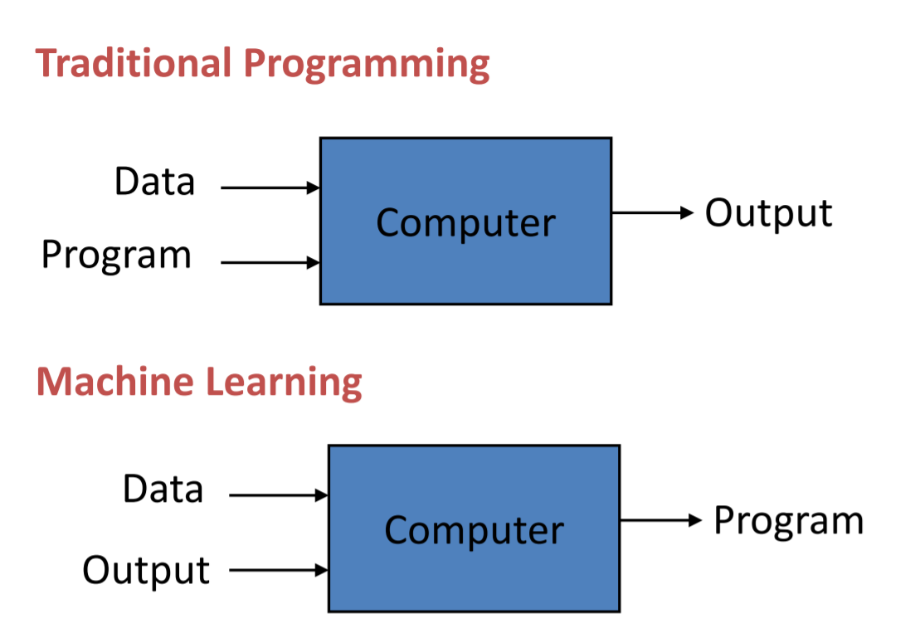
Traditional Programming VS Machine Learning

Slide 7
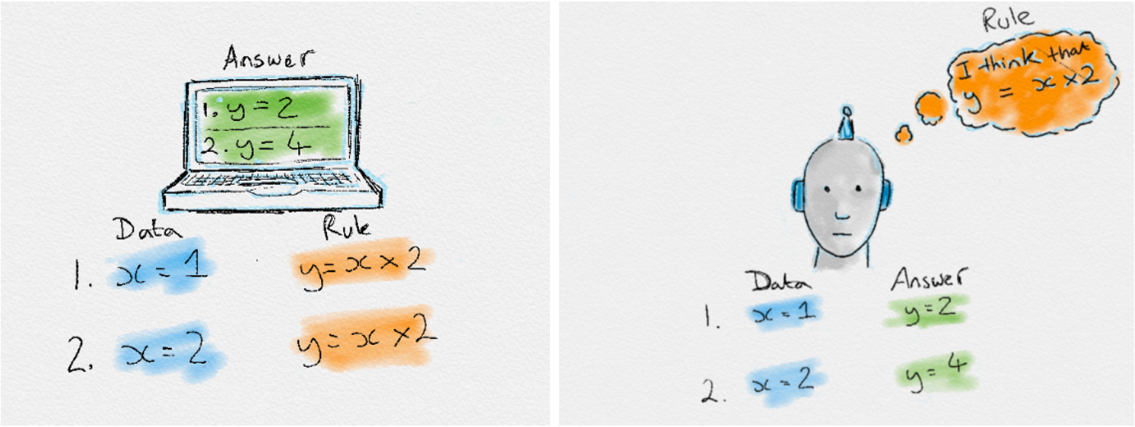
Traditional Programming VS Machine Learning

Slide 8
Examples/ Applications of Machine Learning
Recognizing patterns:
Facial identities or facial expressions
Handwritten or spoken words
Medical images
Generating patterns:
Generating images or motion sequences
Recognizing anomalies:
Unusual credit card transactions
Unusual patterns of sensor readings in a nuclear power plant
Prediction:
Future stock prices or currency exchange rates

Slide 9
Explore these Applications of ML
Web search
Computational biology
Finance
E-commerce
Space exploration
Robotics
Information extraction
Social networks
Debugging software
Which is the area of ML in which you are interested the most?????

Slide 10
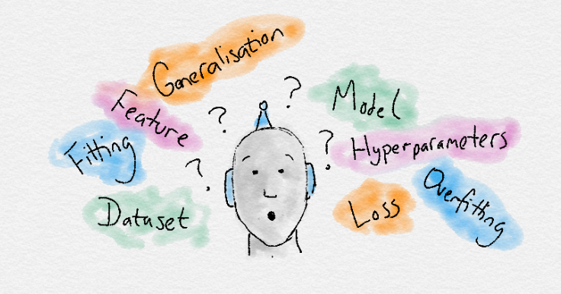
Terminologies of ML
Dataset: A set of data examples, that contain features important to solving the problem.
Features: Important pieces of data that help us understand a problem. These are fed in to a Machine Learning algorithm to help it learn.
Model: The representation (internal model) of a phenomenon that a Machine Learning algorithm has learnt. It learns this from the data it is shown during training. The model is the output you get after training an algorithm. For example, a decision tree algorithm would be trained and produce a decision tree model.
Labels: Answers
Training: Making model learn on the basis of the data (train set)
Testing: Model evaluation on test set.
Total Samples: Rows in your data (structured data)
https://www.kaggle.com/

Slide 11
Dataset
A collection of data examples that contain features important to solving the problem. Usually a data set is divided into training and testing sets.
MNIST dataset: Consists of 60,000 training images and 10,000 testing images. Its goal is to correctly classify the handwritten digits 0−9
CIFAR-10 dataset: Consists of 60,000 images related to 10 different objects’ classes (airplanes, automobiles, birds, cats, deer, dogs, frogs, horses, ships, and trucks)
Flowers-17 datasets: It is a 17 category’s dataset with 80 images per class.
ImageNet: Consists of 1.2 million images for training, 50,000 for validation, and 100,000 for testing. It provide 1,000 image categories.

Slide 12
Features
Important pieces of data that help us understand a problem. These are fed in to a Machine Learning algorithm for training the model.
For Example:
In image base datasets, features may be straight line, curve, and corner extracted from pixel values/intensities.
Sepal_length,sepal_wdth, petal_length and petal_width are the features of IRIS flower dateset available at www.kaggle.com

Slide 13
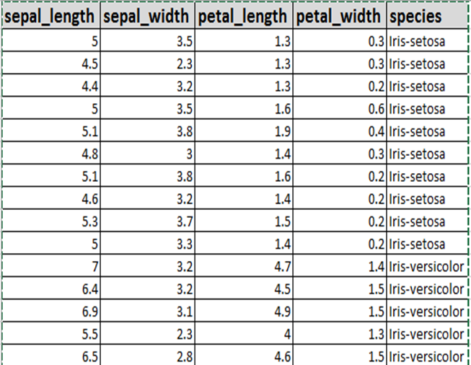
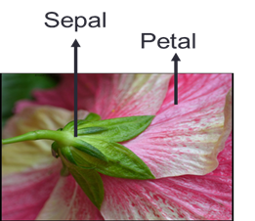
Features
IRIS flower dateset available at www.kaggle.com

Slide 14
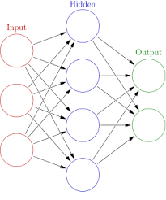
Model
The representation (internal model) of a phenomenon that a Machine Learning algorithm has learnt. It learns this from the data it is shown during training. The model is the output you get after training an algorithm.
For example, a neural network is the example of the model to be trained on train set and produce outputs

Slide 15
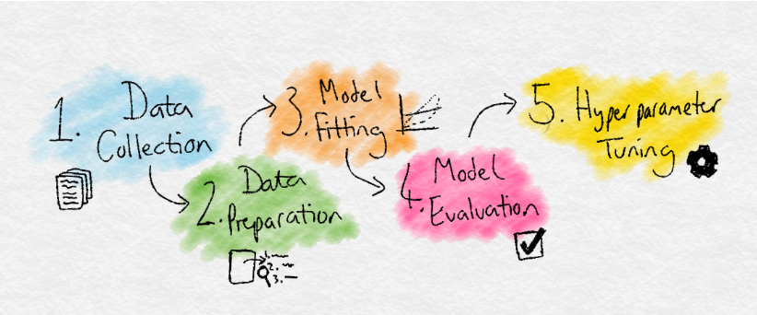
Process of ML
Data Collection: Collect the data that the algorithm will learn from.
Data Preparation: Format and engineer the data into the optimal format, extracting important features and performing dimensionality reduction.
Training: Also known as the fitting stage, this is where the Machine Learning algorithm actually learns by showing it the data that has been collected and prepared.
Evaluation: Test the model to see how well it performs.
Tuning: Fine tune the model to maximise it’s performance.

Slide 16
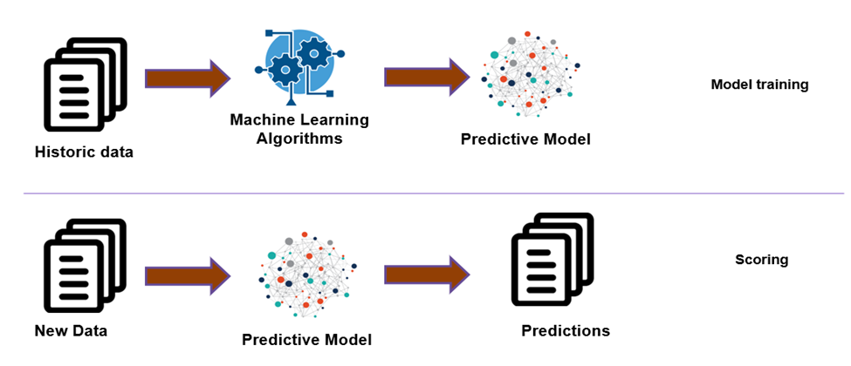

Slide 17
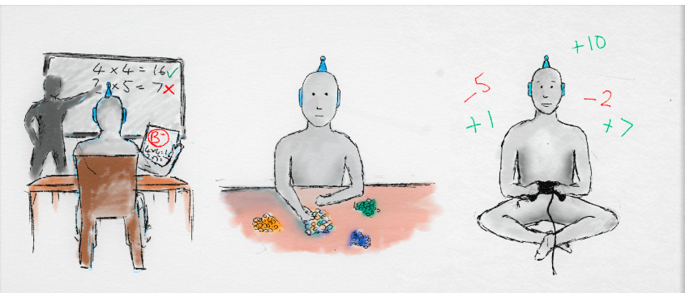
Categories of Machine Learning
Machine learning algorithms are often categorized as follows:
Supervised Learning
Unsupervised Learning
Reinforcement Learning
Sometimes Semi-supervised also

Slide 18
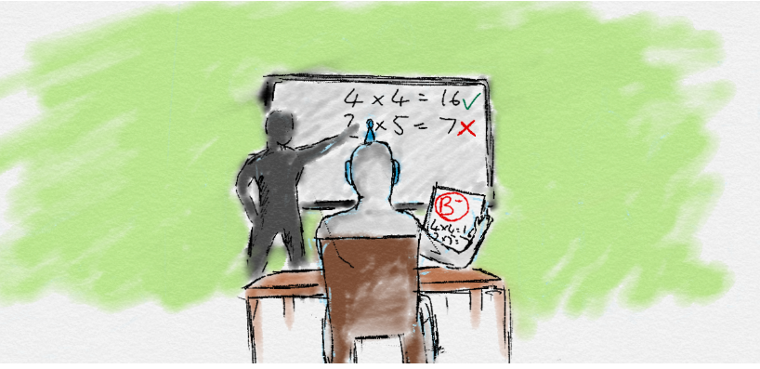
Supervised Learning
In supervised learning, the goal is to learn the mapping (the rules) between a set of inputs and outputs.
For example, the inputs could be the weather forecast, and the outputs would be the visitors to the beach.
The goal in supervised learning would be to learn the mapping that describes the relationship between temperature and number of beach visitors.

Slide 19
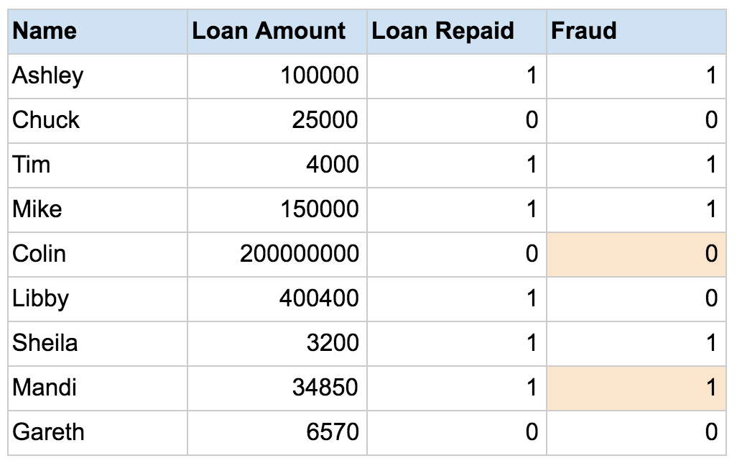
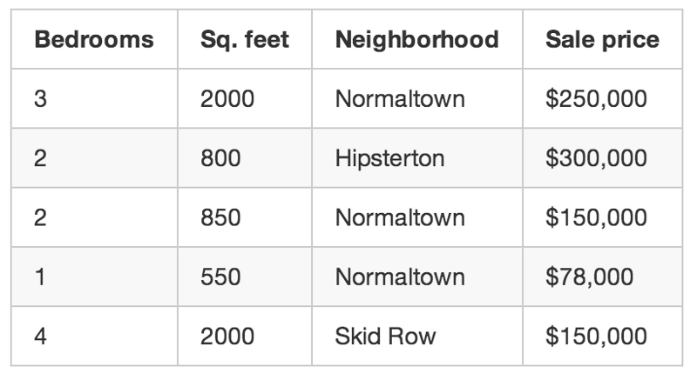

Slide 20
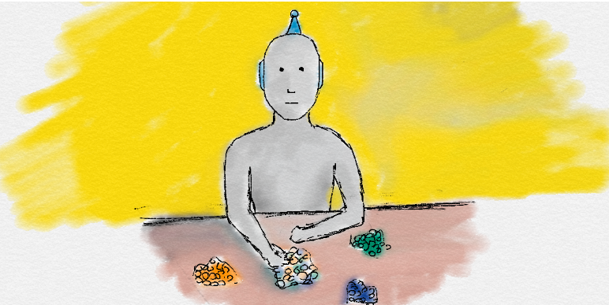
Unsupervised Learning
In unsupervised learning, only input data is provided in the examples.
There are no labelled example outputs to aim for.
But it is still possible to find many interesting and complex patterns hidden within data without any labels.
For example, unsupervised learning in real life would be sorting different colour coins into separate piles.
Nobody taught you how to separate them, but by just looking at their features such as colour, you can see which colour coins are associated and cluster them into their correct groups.

Slide 21
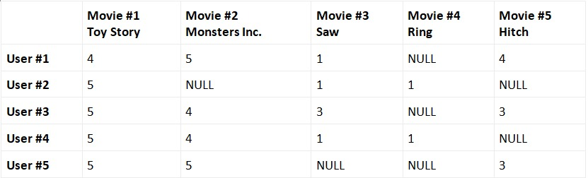

Slide 22
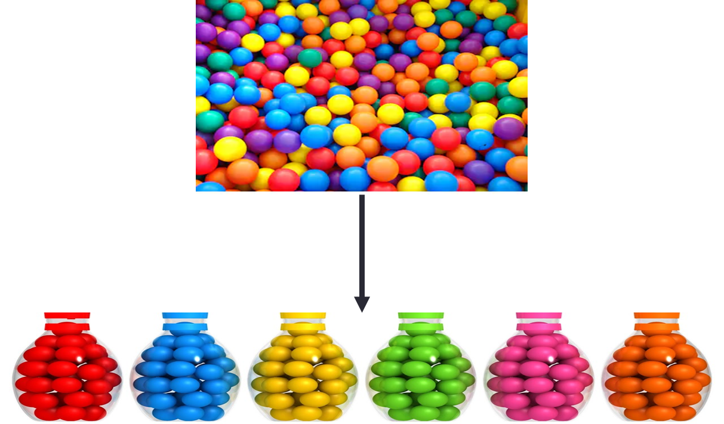
Unsupervised Learning
Example:
Clustering of similar documents together
Grouping of input data by analyzing the patterns

Slide 23
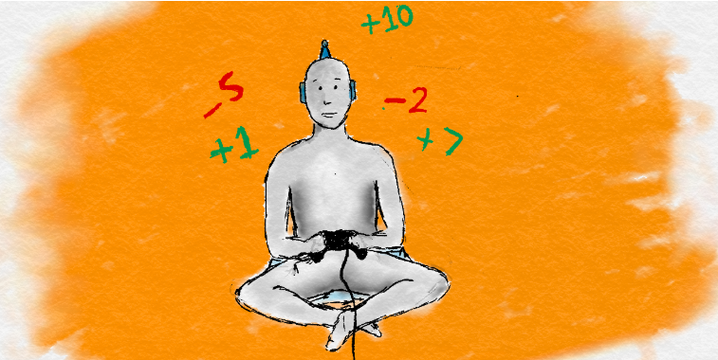
Reinforcement Learning
Another type of machine learning is Reinforcement learning.
It is less common and much more complex, but it has generated incredible results. It doesn’t use labels as such, and instead uses rewards to learn.
If you’re familiar with psychology, you’ll have heard of reinforcement learning.
If not, you’ll already know the concept from how we learn in everyday life.
In this approach, occasional positive and negative feedback is used to reinforce behaviours.
Think of it like training a dog, good behaviours are rewarded with a treat and become more common. Bad behaviours are punished and become less common. This reward-motivated behaviour is key in reinforcement learning.

Slide 24
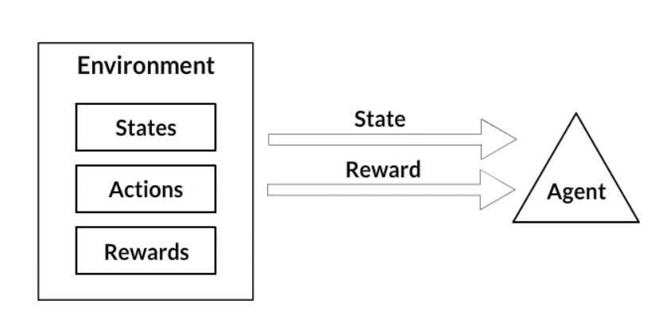
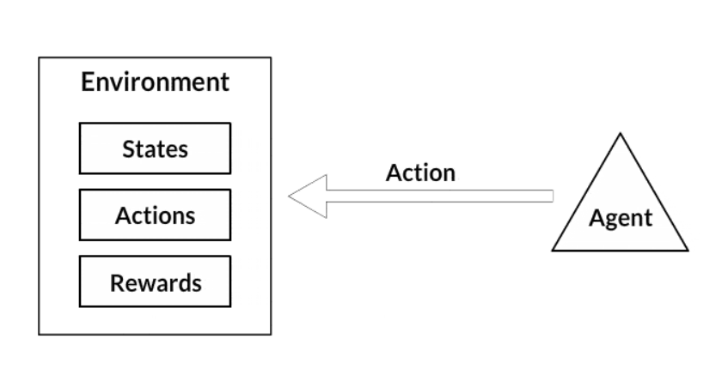
Reinforcement Learning – Think

Slide 25
Reinforcement Learning – Think
This is very similar to how we as humans also learn. Throughout our lives, we receive positive and negative signals and constantly learn from them. The chemicals in our brain are one of many ways we get these signals. When something good happens, the neurons in our brains provide a hit of positive neurotransmitters such as dopamine which makes us feel good and we become more likely to repeat that specific action. We don’t need constant supervision to learn like in supervised learning. By only giving the occasional reinforcement signals, we still learn very effectively.
One of the most exciting parts of Reinforcement Learning is that is a first step away from training on static datasets, and instead of being able to use dynamic, noisy data-rich environments. This brings Machine Learning closer to a learning style used by humans. The world is simply our noisy, complex data-rich environment.
Games are very popular in Reinforcement Learning research. They provide ideal data-rich environments. The scores in games are ideal reward signals to train reward-motivated behaviours. Additionally, time can be sped up in a simulated game environment to reduce overall training time.
A Reinforcement Learning algorithm just aims to maximise its rewards by playing the game over and over again. If you can frame a problem with a frequent ‘score’ as a reward, it is likely to be suited to Reinforcement Learning.
Reinforcement learning hasn’t been used as much in the real world due to how new and complex it is. But a real world example is using reinforcement learning to reduce data centre running costs by controlling the cooling systems in a more efficient way. The algorithm learns a optimal policy of how to act in order to get the lowest energy costs. The lower the cost, the more reward it receives.

Slide 26
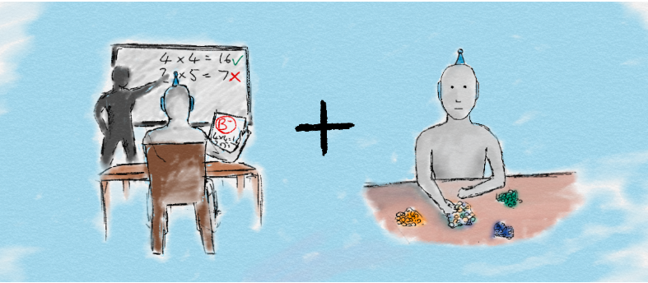
Semi-supervised learning
Semi-supervised learning is a mix between supervised and unsupervised approaches.
The learning process isn’t closely supervised with example outputs for every single input, nor the algorithm do its own thing without any form of feedback.
Semi-supervised learning takes the middle road, by being able to mix together a small amount of labelled data with a much larger unlabelled dataset.
It reduces the burden of having enough labelled data.
Therefore, it opens up many more problems to be solved with machine learning.

Slide 27
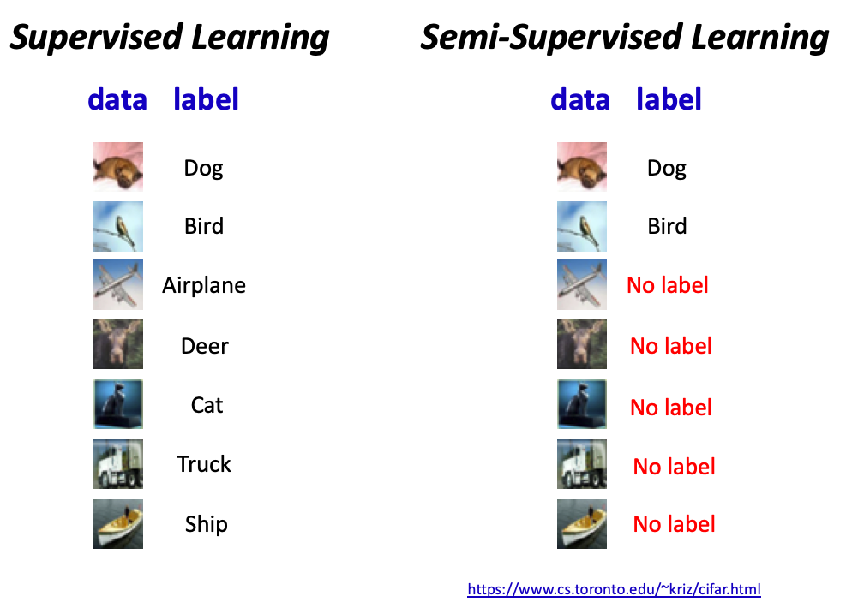

Slide 28
Thanks

